Slide 1

HTML Forms

Slide 2
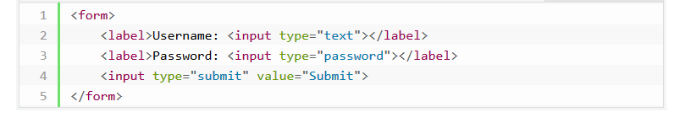
What is HTML Form
HTML Forms are required to collect different kinds of user inputs, such as contact details like name, email address, phone numbers, or details like credit card information, etc.
Forms contain special elements called controls like inputbox, checkboxes, radio-buttons, submit buttons, etc. Users generally complete a form by modifying its controls e.g. entering text, selecting items, etc. and submitting this form to a web server for further processing.

Slide 3
Input Element
This is the most commonly used element within HTML forms.
It allows you to specify various types of user input fields, depending on the type attribute. An input element can be of type text field, password field, checkbox, radio button, submit button, reset button, file select box, as well as several new input types introduced in HTML5.
The most frequently used input types are described further.

Slide 4
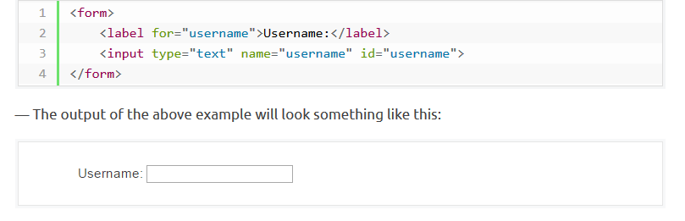
Text Fields
Text fields are one line areas that allow the user to input text.
Single-line text input controls are created using an <input> element, whose type attribute has a value of text. Here's an example of a single-line text input used to take username:

Slide 5
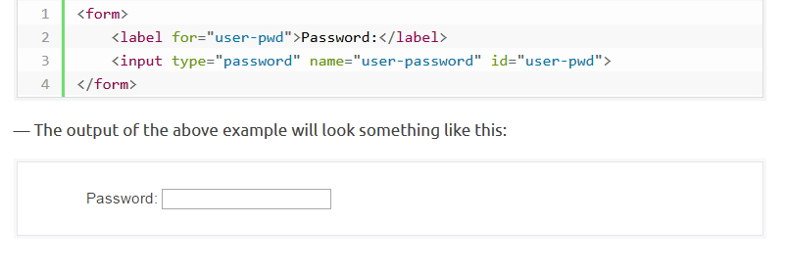
Password Field
Password fields are similar to text fields. The only difference is; characters in a password field are masked, i.e. they are shown as asterisks or dots. This is to prevent someone else from reading the password on the screen. This is also a single-line text input controls created using an <input> element whose type attribute has a value of password.

Slide 6
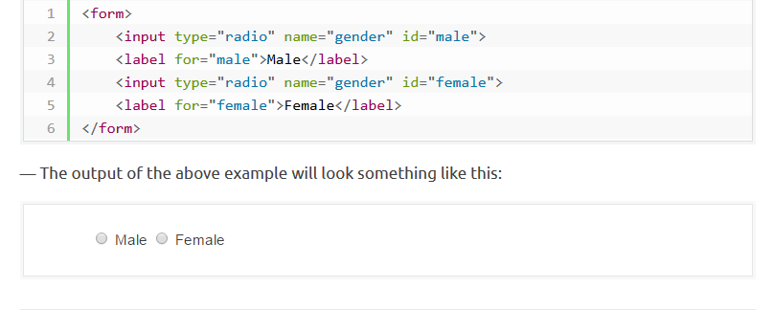
Radio Buttons
Radio buttons are used to let the user select exactly one option from a pre-defined set of options. It is created using an <input> element whose type attribute has a value of radio.

Slide 7
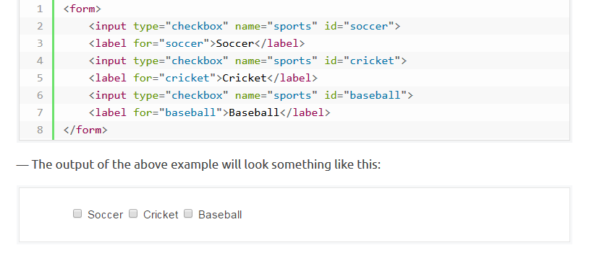
Checkboxes
Checkboxes allows the user to select one or more option from a pre-defined set of options. It is created using an <input> element whose type attribute has a value of checkbox.

Slide 8
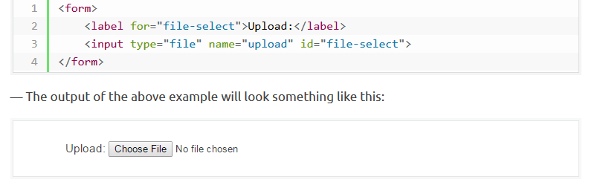
File Select box
The file fields allow a user to browse for a local file and send it as an attachment with the form data. Web browsers such as Google Chrome and Firefox render a file select input field with a Browse button that enables the user to navigate the local hard drive and select a file.

Slide 9
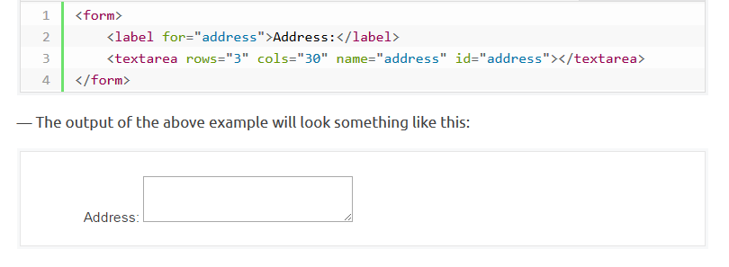
Textarea
Textarea is a multiple-line text input control that allows a user to enter more than one line of text. Multi-line text input controls are created using an <textarea> element.

Slide 10
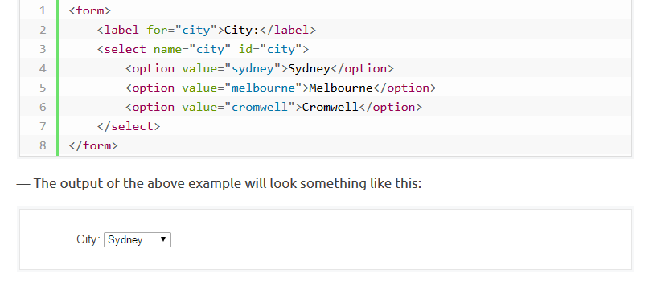
Select Boxes
A select box is a dropdown list of options that allows user to select one or more option from a pull-down list of options. Select box is created using the <select> element and <option> element.

Slide 11
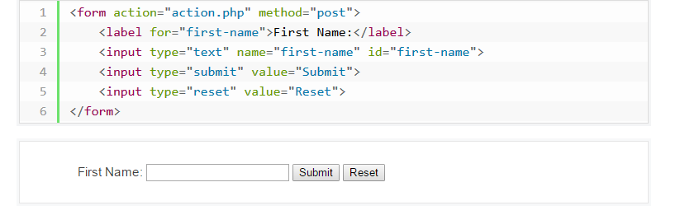
Submit and Reset Buttons
A submit button is used to send the form data to a web server. When submit button is clicked the form data is sent to the file specified in the form's action attribute to process the submitted data.
A reset button resets all the forms control to default values. Try out the following example by typing your name in the text field, and click on submit button to see it in action.

Slide 12
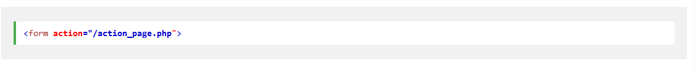
Form Attributes
The action attribute defines the action to be performed when the form is submitted.
The target attribute specifies if the submitted result will open in a new browser tab, a frame, or in the current window.The default value is "_self" which means the form will be submitted in the current window.To make the form result open in a new browser tab, use the value "_blank":

Slide 13
The method attribute specifies the HTTP method (GET or POST) to be used when submitting the form data:

